Slide 1
Survey of Popular Link Prediction Algorithms
CS 768 Course Project
Abhinav Kumar 180050003
Nimay Gupta- 180050068
Niraj Mahajan - 180050069

Slide 2
Introduction
Due to the increasing surge in the research on complex graphical models, a considerable attention is devoted to Social Networks and their properties
A social network is a graph where the nodes represent entities or people, and the edges represent a link or connection between them
Link Prediction is defined as: Given a snapshot of a social network at time t, we seek to accurately predict the edges that will be added to the network during the interval from time t to a given future time t’
In other words, we need to use the intrinsic features of a social network to define a measure of proximity or similarity between any two nodes, and thus predict the probability of a link between the two.

Slide 3
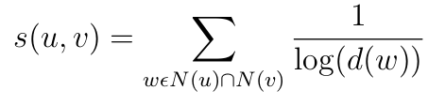
Heuristic-Based methods
Common Neighbours: Score(u,v) = |Γ(u) ∩ Γ(v)|
Preferential Attachment: Score(u,v) = |Γ(u)|.|Γ(v)|
Adamic Adar:
Instead of simply computing the number of common neighbors, we compute a weighted sum, weighing rarer features more heavily.
Score:
Jaccard coefficient: score(u, v) = |Γ(u) ∩ Γ(v)| / |Γ(u) ∪ Γ(v)|

Slide 4
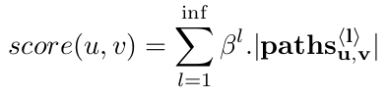
Heuristic-Based methods (ctd)
Katz measure:
Katz defines a measure that directly sums over the collection of paths between two nodes, exponentially damped by path length.
For nodes u,v, define paths u,v as the set of all l-length paths between nodes u,v.
where β > 0 is a dampening parameter. Using the adjacency matrix A, we can get the Katz matrix by solving the infinite geometric progression, as K = (I − βA) −1 − I.

Slide 5
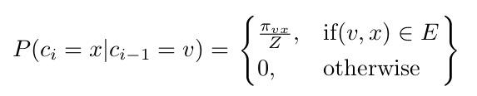
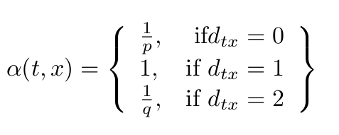
Node2vec
Random walk
Search bias (alpha)

Slide 6
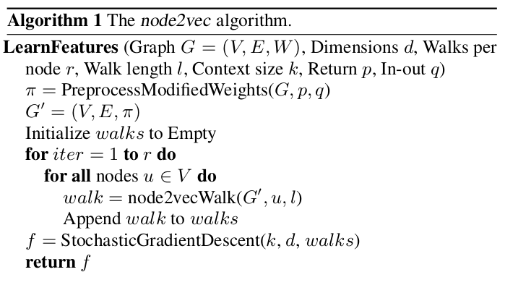
Node2vec (ctd)

Slide 7
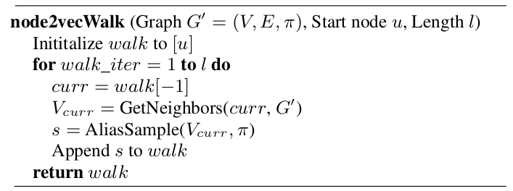
Node2vec (ctd)

Slide 8
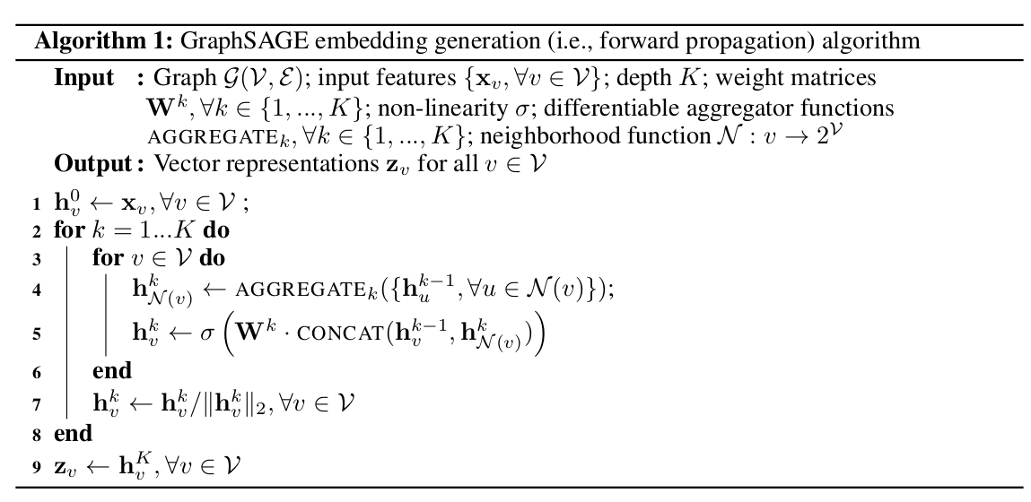
Graphsage

Slide 9
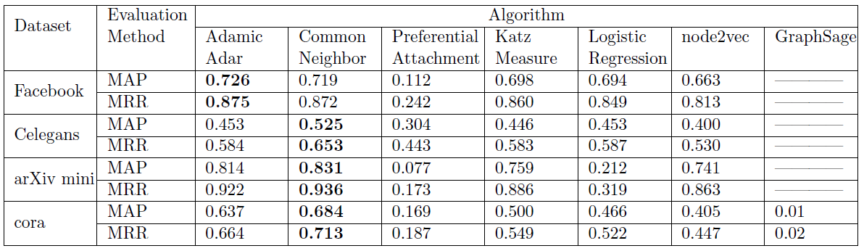
Experimental Results

Slide 10
Performance of Heuristics
Common Neighbors gives us the best results for cora, arXiv and C-elegans graph
Adamic Adar gives the best results for the facebook graph.
Adamic Adar weights the score according to the degree of the common neighbor and this shields our score from being influenced by celebrity nodes.
Such nodes can be frequently occurring in the facebook graph, but will be less frequent in citation graphs or C-elegans graph

Slide 11
Performance of Heuristics
Preferential Attachment performs poorly as it is based on linking highly (socially) active nodes.
This is a bad measure since it is improbable that an edge can be established between any two random nodes, just because they are socially active.
For example it is absurd to say that two researchers, one in Computer Vision and one in Earth Science, will collaborate on a project

Slide 12
Performance of node2vec and GraphSage
Node2vec gives sub optimal results as compared to the heuristic based approaches
GraphSage gives really bad results.
The embeddings obtained using GraphSage give an 86.20% accuracy(F1-score) for node classification.
Since the graph is extremely sparse ( 0.04 test fraction) the embeddings contain only the nodes' intrinsic information, and fail to extract the neighborhood information.
This makes it difficult to train a logistic regression on the embeddings obtained from such sparse graphs. Another reason could be that embeddings learnt are not transferable to other task hence poor results

